Slide 1
Accident detection and vehicle tracking using Arduino
By:
Abhay Rathi 20BCE2905

Slide 2
introduction
The main purpose of this project is to help detect the accident and to find the accident spot at any place and informing it to police and hospital through GPS and GSM networks.
The GPS based vechile accident identification module contains Relay module, GSM module and a GPS modem connected to the Arduino.
Global System for Mobile(GSM) technology is used to establish cellular connection
Gps is used to trace the position of the vehicle

Slide 3
Introduction…
It is very difficult to know that an accident has occurred in deserted areas, hilly regions and to locate the position where it has happened.
There is no system of identification and intimation regarding an accident in previous existing system
Later on the SMS service begins for intimation purpose
GPS and GSM makes the usage for intimation and identification of place

Slide 4
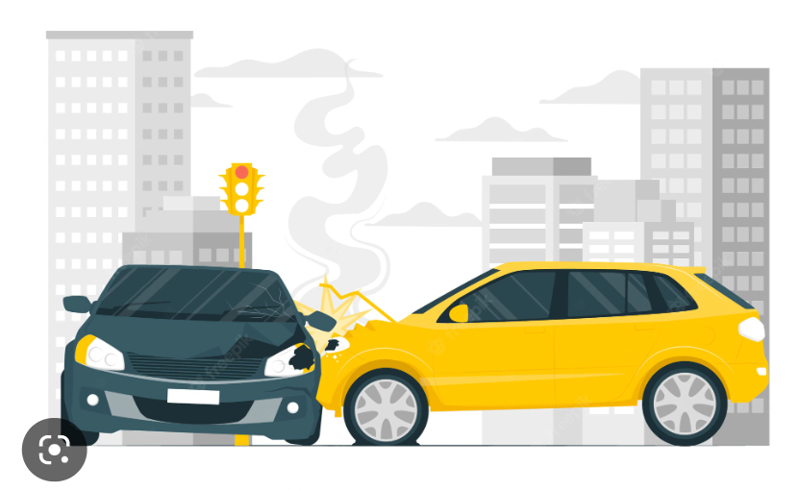
Previous system
When an accident oocurs the information only is sent through GSM but there is no possibly to locate the spot

Slide 5
Proposed system
This project presents and automotive localization system using GPS and GSM-SMS services.

Slide 6
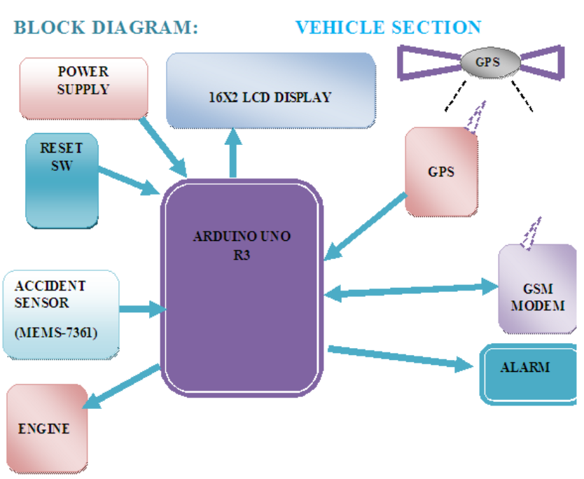
Block diagram

Slide 7
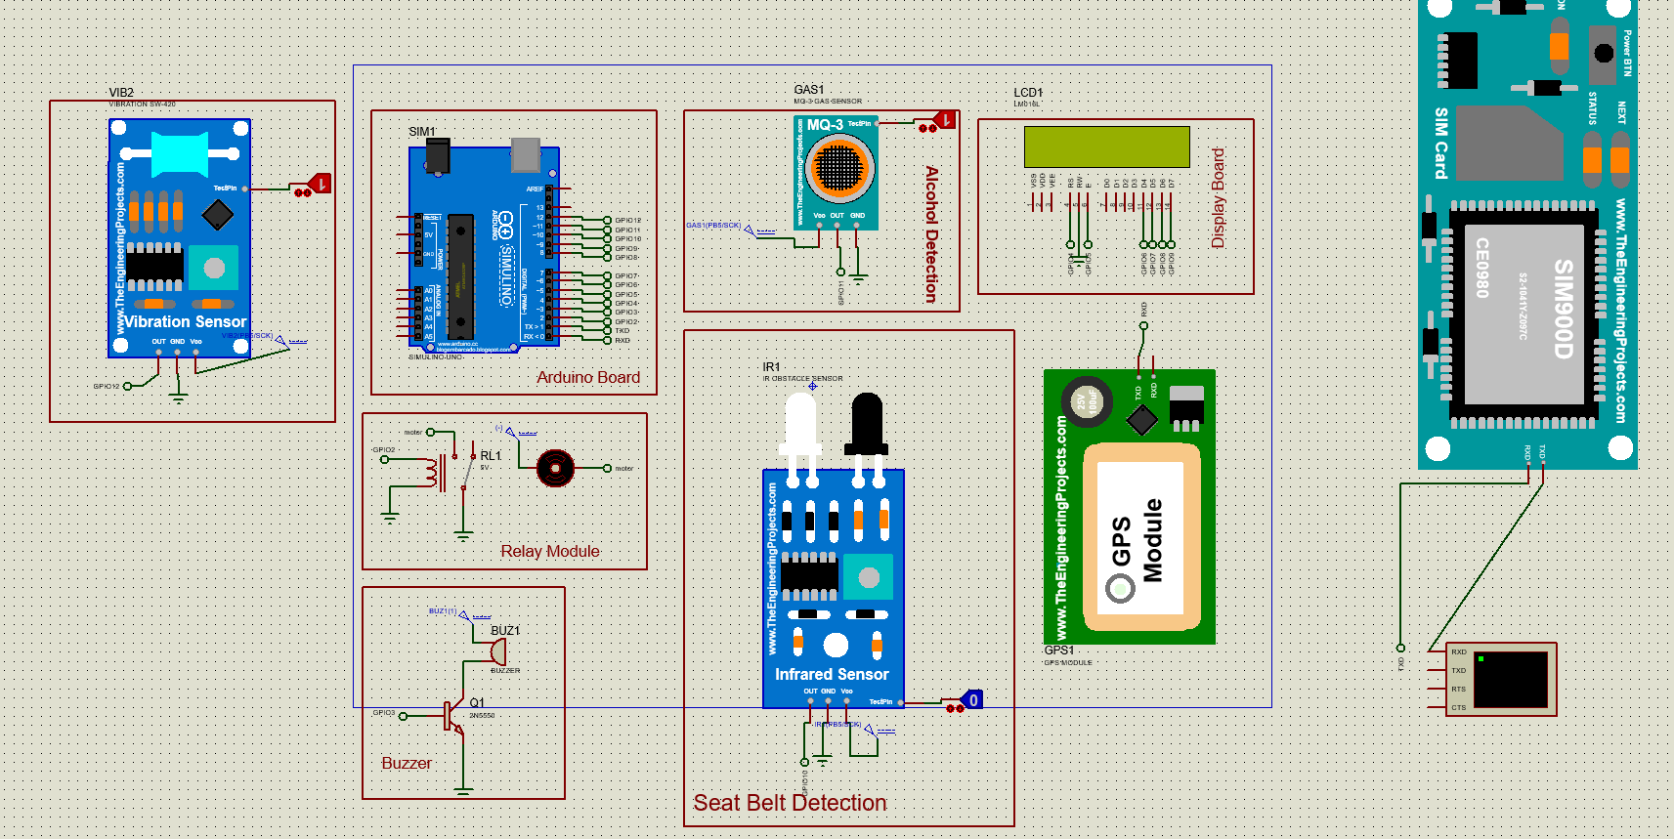

Slide 8
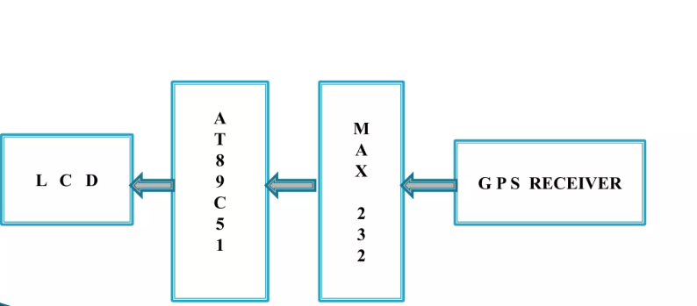
Block diagram: receiver section

Slide 9
Circuit components
Power supply
Arduino
Gps module
Infrared sensor
Alcohol sensor
GSM module
Relay motor
Vibration sensor
Liquid crystal display

Slide 10
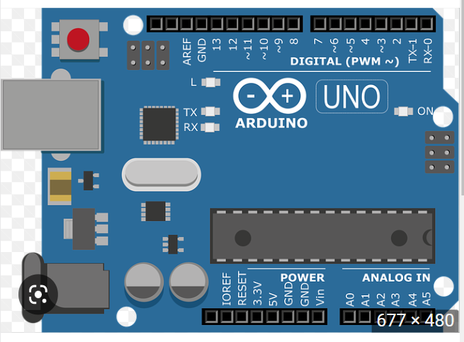
arduino

Slide 11
Global positioning system
GPS system:
27 satellites
Orbit the earth twice a day
Equipped with an atomic clock
GPS Receiver
3-D trilateration
GPS receiver locates 4 satellites above it
Then it calculates the distance to GPs satellites

Slide 12
GPS module
The GPS module GPS1 is used
High performance receiver tracks upto 20 satellites
The module communicates with application system via protocol
Avergae cold start time under 42 seconds

Slide 13
GSM Modem
A gsm modem is a wireless modem that works with a GSM wireless network.
A wireless modem behaves like a dial-up modem
The main difference between them is that a dial-up modem sends and recives data through a fixed line while a wireless modem sends and receives datat through radio waves

Slide 14
Gsm modem…
The GSM network is used to provide communication from one place to other
The GSM module using consists of a Mobile Station and SIM
The commands that are using to provide communication are AT commands
The AT commands specifies the GSM technology are related t SMS service

Slide 15
General characteristics of a GSM MOdem
Reading and writing and deleting SMS messages
Sending SMS messages
Monitoring the signal Strength
Monitoring the charging status and chargelevel of the batter Reading, writing and searching phone book entries. The number of SMS messages that can processed by a GSM modem per minute is very low – only six to ten SMS message per minute

Slide 16
Sensors and their uses
Infrared Sensor: to detect if the driver has put on his seatbelt
MQ-3 Sensor: to detect alcohol consumption
DC-motor: The relay module which will indicate starting of car
Vibration Sensor: To detect if accident has occurred
GSM: to transmit gps longitude and latitude values to the given phone number
GPS: to detect the location of the accident
Buzzer: it will buzz if the driver has consumed alcohol or not put on seatbelt

Slide 17
LCD liquid crystal display
In LCD we will connect the RW to the ground
D4, D5, D6, D7 we will connect these default pin to respective GPIO6, GPIO7, GPIO8, GPIO9 of the Arduino.
Then we will connect the RS to GPIO4.
Enable pin to GPIO5

Slide 18
MQ-3 Sensor
VCC- we will connect the vcc to vcc using DC wire
OUT- we will connect to aurdino through GPIO12
GND- we will connect ground pin to ground
Test pin- we will connect this to logic state to get true or false values

Slide 19
IR sensor
Infrared sensor
Out – we will connect to the GPIO10
GND- ground to ground connection will be done
VCC- vcc to vcc will be connected
Testpin – we will connect this to logic state to detect presence of seatbelt

Slide 20
Vibration sensor
OUT- connect to GPIO12 of Arduino
GND- ground is connected to ground
VCC- the vcc is connected to vcc
Test pin- will be connected to logic state of accident has/hasn’t occurred

Slide 21
Power supply to all module is 5v

Slide 22
GPS module
Txd pin of GPS is connected to RXD pin of Arduino
Because the GPS is sending a signal and Arduino is receiving the signal

Slide 23
GSM MOdule
Requires serial termial/ virtual terminal
Here we will connect Txd of Arduino to Rxd of terminal because Arduino is sending and terminal is reciving

Slide 24
Buzzer
We will connect pin 1 to vcc
We will connect pin 2 to transistor then trastistor to ground

Slide 25
VCC is the power input of a device. It can be positive or negative with respect to gnd usually to 5v

Slide 26
Relay module: dc motor
Here we will connect vcc to vcc.
Transmitor ground to ground will be connected
We wil connect it to GPIO2 of Arduino

Slide 27
Result and discussion
Thus by connecting the 5GPIOS to the Arduino we are able to make a accident detection system

Slide 28
Future work and updates
As we will be able to collect lot of data about the accident location and time.
We can use this data in big data analytics and with help of machine learning we can find which area at which time are more prone to accident

